Slide 1
Check Off 1 Music Notation to Audio Sheet Trainer
Cameron Henning

Slide 2



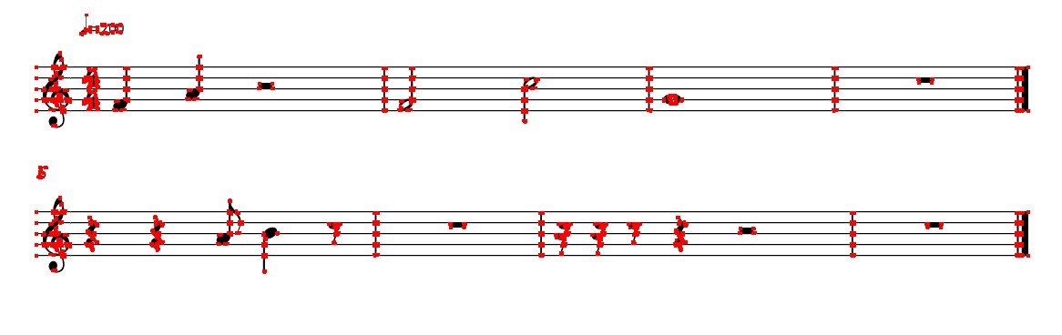
Harris Corner Detection
Detect Corners from each template
Detect Corners from each music variable in the sample sheet
Compatibility issues – cannot directly compare corners from templates to corners from music sheet

Slide 3
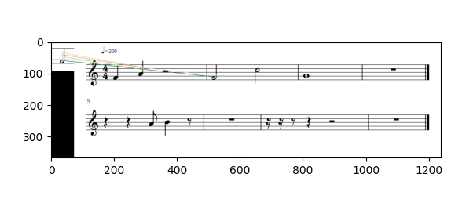
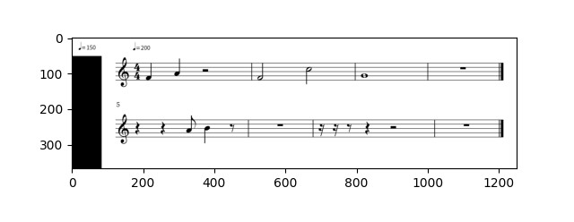
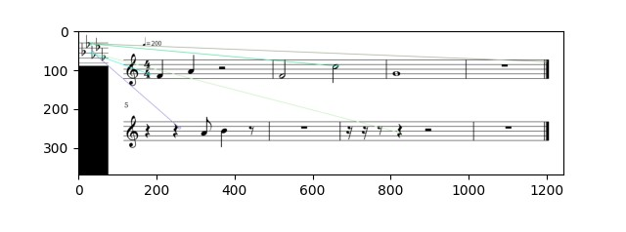
ORB (Oriented FAST and Rotated BRIEF)
Key-point detector, creates binary feature vectors from a set of key points, uses Hamming distance
Uses Brute-Force Matching
Takes descriptor of the templates and matches it with all of the descriptors pulled from the music sheet
ORB least accurate
Wrongly identified notes or didn’t identify them at all
Only a few came out accurate

Slide 4
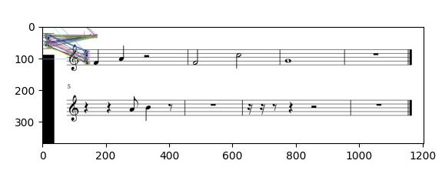
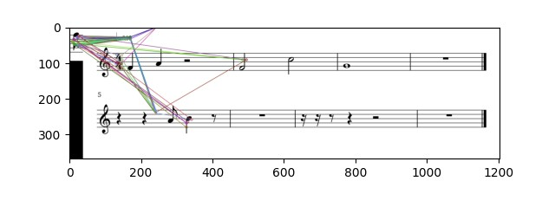
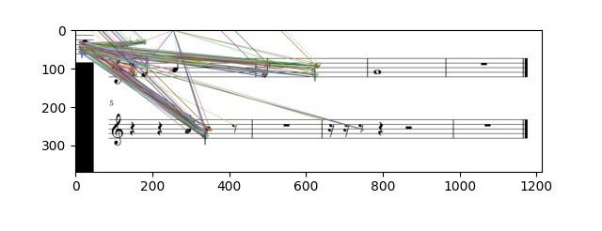
SIFT (Scale-Invariant Feature Transform)
Detects and describes local features in images
Correctly matched some notes
SIFT matched too much
Too many similar features
Not enough unique features for each template
Did not correctly set the threshold for the matches

Slide 5
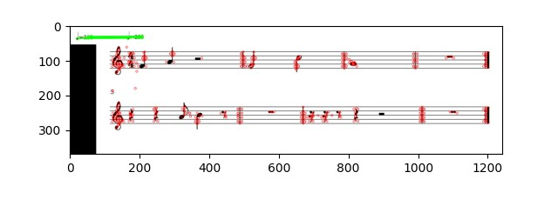
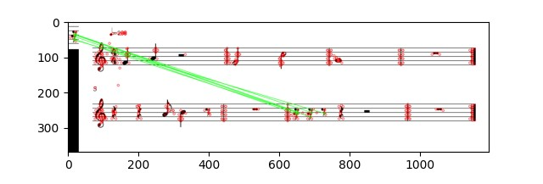
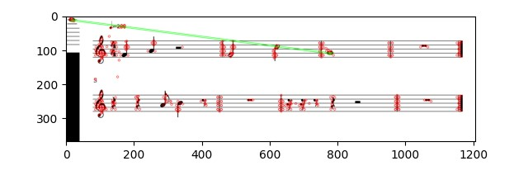
SIFT w/ FLANN matcher
FLANN
Fast Library for Approximate Nearest Neighbor
Used for large datasets and for high dimensional features
Faster than Brute-force
Most Accurate Results
Shows all features pulled from training image
Shows the matches it found
Decent accuracy, but still confused some notes with others

Slide 6
Goals for the Midterm Presentation
Combine a descriptor with Harris Corner Detection or use normalized cross-correlation with a descriptor (to get rid of bad matches)
Get a measured accuracy of 80% or better
Start the postprocessing algorithm
Run a few tests with the camera

